Slide 1

Team Name : NEURO BHARAT
Team Leader Name : SOMPETA PAVAN KUMAR
Problem Statement : AI FOR MEDIA ,CONTENT & DIGITAL EXPERIENCES

Slide 2
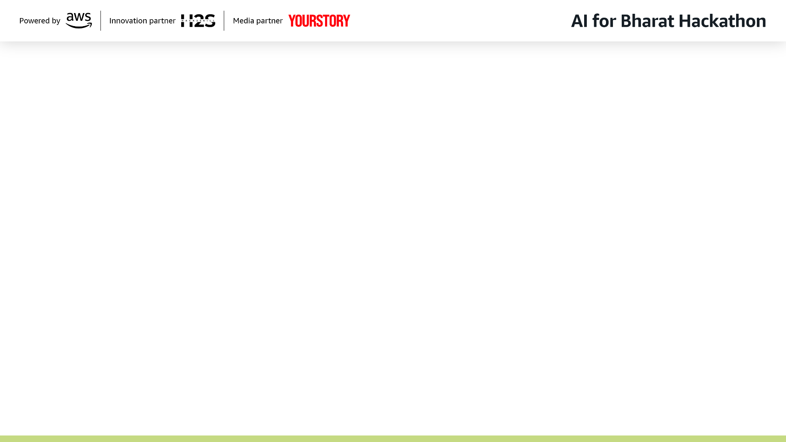
Brief about the Idea:
A large portion of Bharat’s population remains digitally underrepresented due to the lack of local-language content, region-specific digital experiences, and accessible media tools. Content creation and distribution platforms today are largely English-centric, urban-focused, and resource-heavy, making it difficult for rural creators, local journalists, educators, small businesses, and community leaders to effectively create, personalize, and share digital content.

Slide 3
Proposed Solution:
Design an AI-driven multilingual content intelligence platform that empowers Bharat’s creators to create, localize, personalize, and distribute digital content in regional languages with minimal technical effort.
The platform will leverage Generative AI, NLP, and speech technologies to:
Generate and transform content (text, audio, video scripts) in multiple Indian languages
Automatically simplify, summarize, and localize content for different regions and audiences
Assist small creators and local businesses with content planning, optimization, and scheduling
Enable voice-first and low-bandwidth content creation for wider accessibility
Analyze engagement and recommend improvements tailored to local audiences
Impact: This solution democratizes digital media creation by giving Bharat a strong local voice. It bridges the content gap between urban and rural India, boosts regional creativity, strengthens local economies, and ensures that digital experiences truly reflect the diversity of Bharat.

Slide 4
Features Offered by the Solution: 1.Multilingual Content Generation 2.Smart Content Simplification & Summarization 3.Voice-First Content Creation 4.Content Personalization Engine 5.AI Content Planner & Scheduler
6.Engagement & Insight Analytics 7.Low-Bandwidth & Mobile-Optimized Design

Slide 5
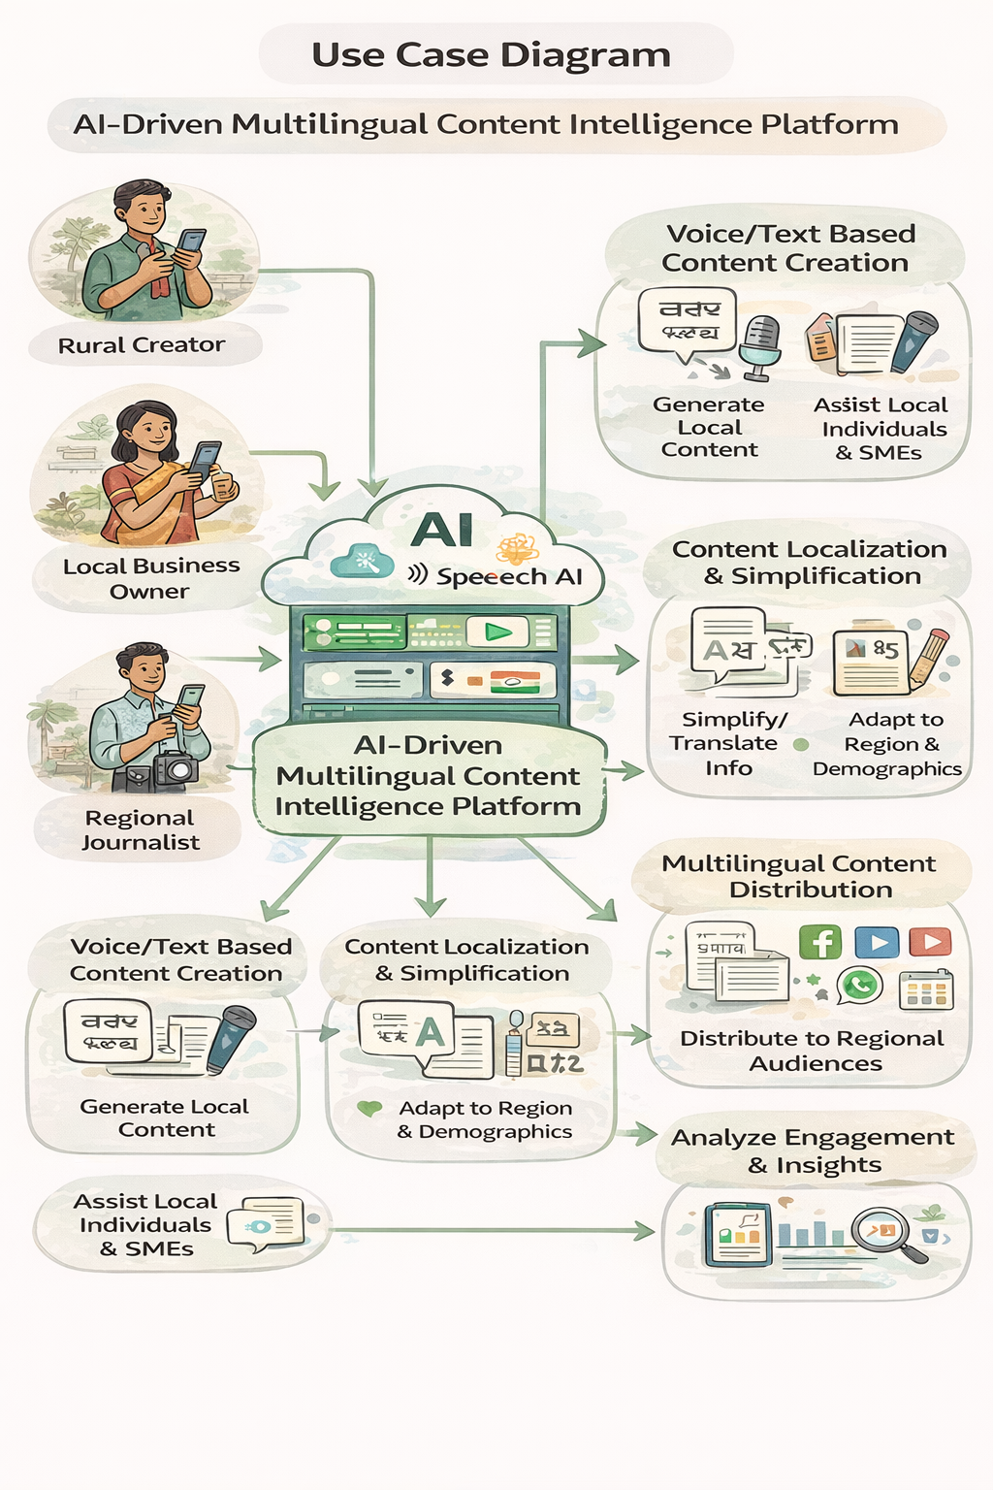
Process flow diagram or Use-case diagram :
.

Slide 6
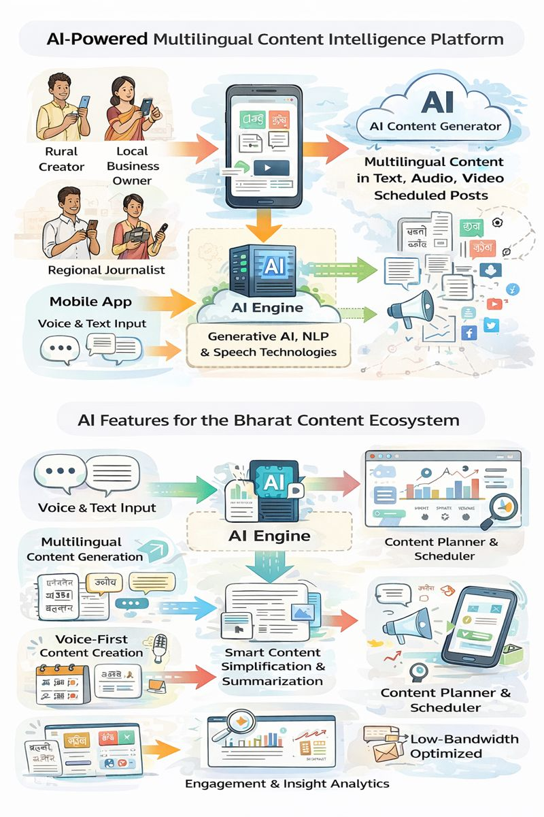
Wireframes/Mock diagrams of the proposed solution (optional)

Slide 7
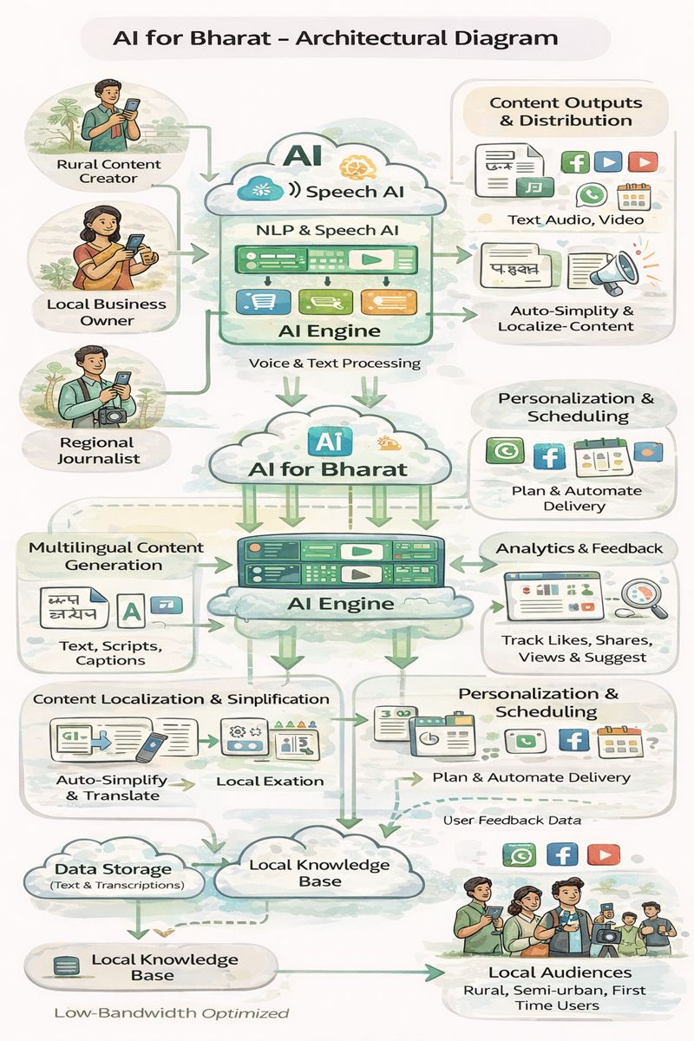
Architecture diagram of the proposed solution:

Slide 8
Technologies to be used in the solution:
Artificial Intelligence & Machine Learning: Large Language Models (LLMs) , Natural Language Processing (NLP), Speech-to-Text (STT), Text-to-Speech (TTS), Recommendation Engine.
Backend & APIs: 1.Python (FastAPI / Flask)
2.Node.js (Express.js)
3.REST APIs / GraphQL
Frontend & User Interface:
1.React.js / Next.js 2.Flutter / React Native 3. Progressive Web App (PWA)

Slide 9
Database & Storage:
MongoDB / Firebase ,PostgreSQL ,Object Storage (AWS S3 / GCP Storage)
Cloud & Deployment:
AWS / Google Cloud / Azure ,Docker Kubernetes (optional) ,CI/CD Pipelines
Analytics & Monitoring:
Google Analytics / Mixpanel,Custom AI Analytics Engine,Prometheus + Grafana
Security & Accessibility:
Auth 2.0 / JWT,Role-Based Access Control (RBAC),Data Encryption (AES / TLS),WCAG Accessibility Standards
IN Bharat-Focused Enhancements:
Indic NLP Libraries (AI4Bharat, IndicBERT),Offline Mode Support,Regional Language UI & Voice Support,Low-bandwidth AI optimization.

Slide 10
Estimated implementation cost (optional):
Cost Breakdown:
AI & NLP (Open-Source Only – IndicBERT, LLaMA, Whisper): ₹90,000
Cloud Infrastructure (Student / Startup credits, minimal VMs): ₹60,000
Web + Mobile App (PWA instead of native apps): ₹80,000
Voice Interface (Open-source STT/TTS): ₹40,000
Testing, Deployment & Maintenance: ₹30,000
Total Cost:
₹3,00,000 (Approx.)

Slide 11


